Slide 1
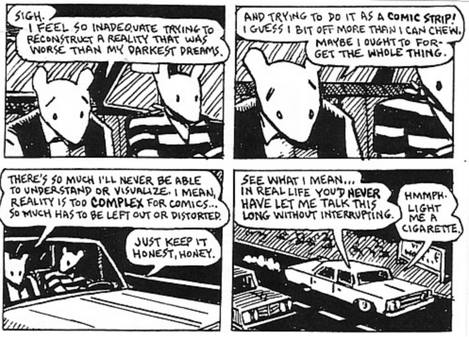
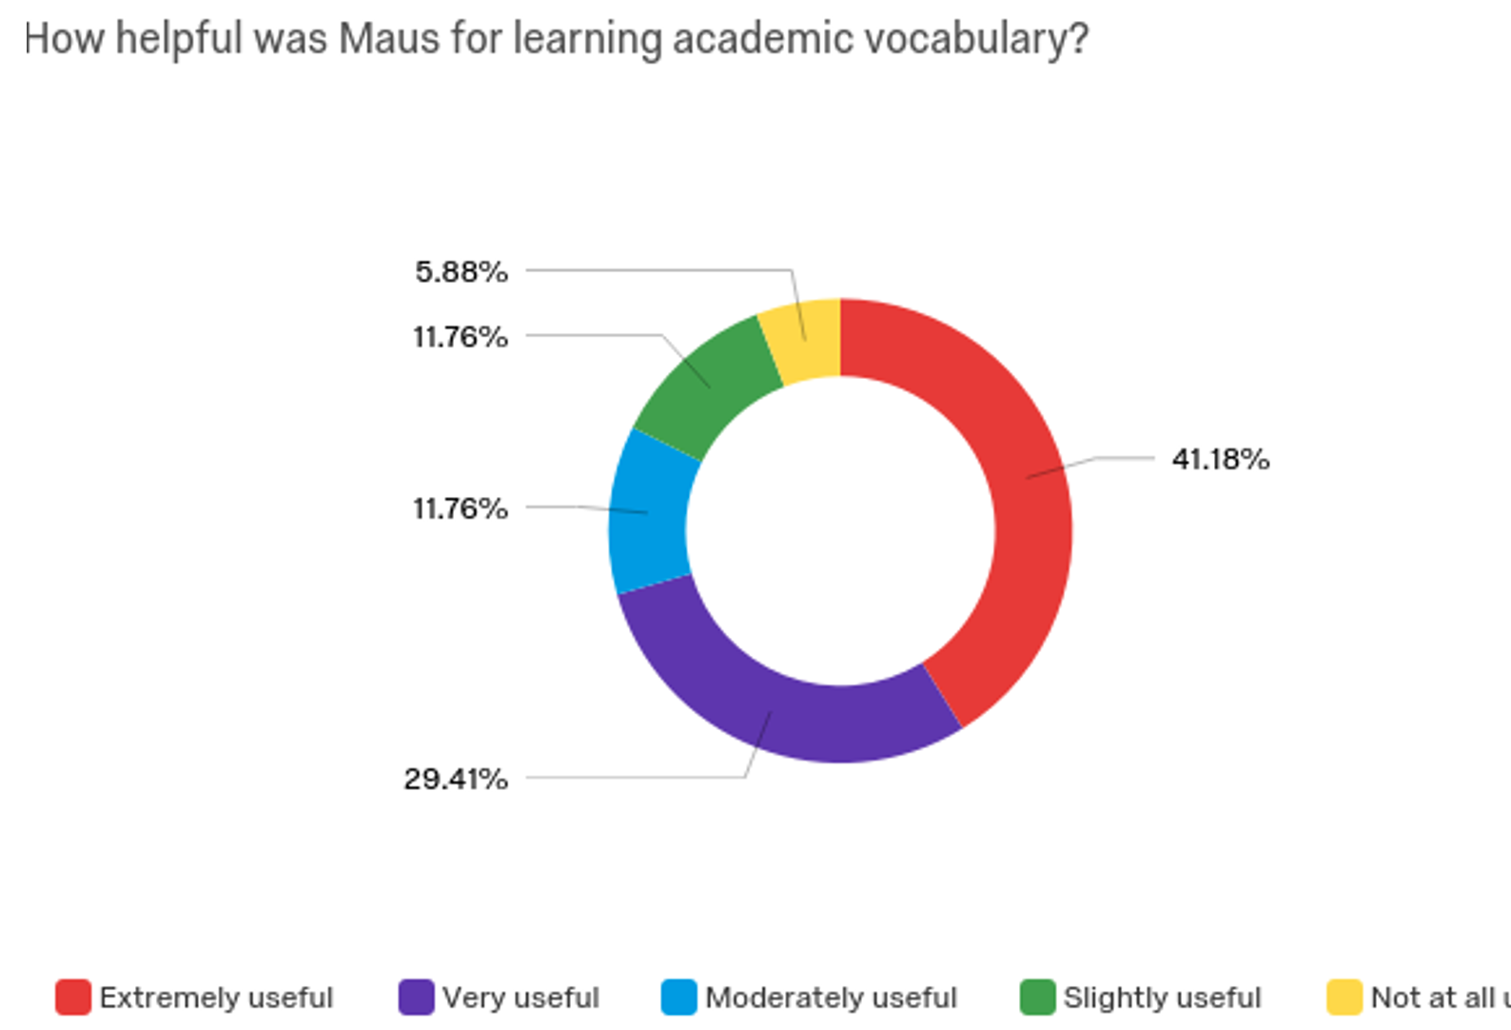
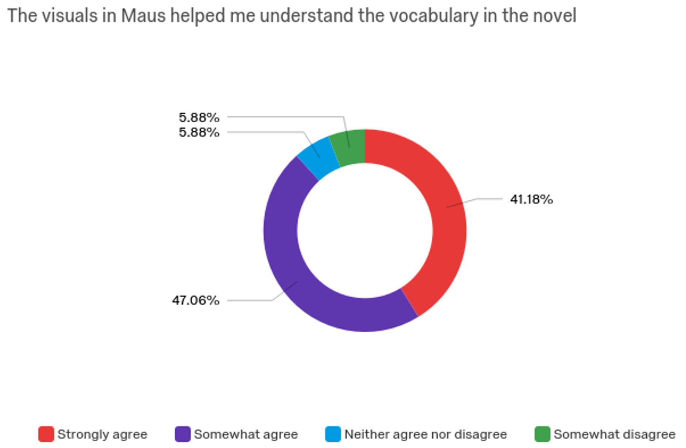
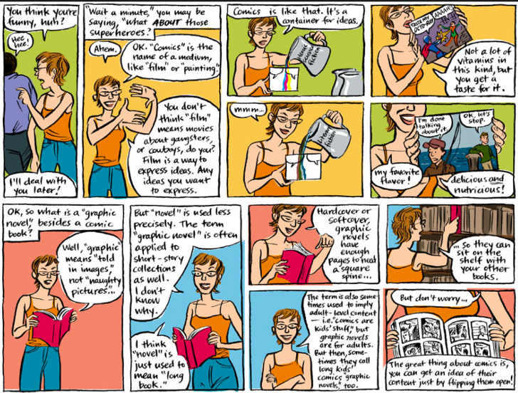
Just Comics? Literacy and Graphic Novels
Luke Duesbery, Paul Kohlmeier, San Diego State University & Todd Twyman, Pacific University, SDSU Center for Teaching Critical Thinking and Creativity
INTRODUCTION
THE GAP IN THE LITERATURE
RESULTS
The multimodal format of the graphic novel can lend itself well to literacy instruction (Brenna, 2012). However, much of the research on graphic novel use in the classroom pertains to reading comprehension.
And while a vital element of language competency, many English learners put a priority on lexicon expansion and accretion of cultural knowledge.
While some research indicates that graphic novels can be used as authentic texts for instruction in reading and writing (Brenna, 2012), that research is mostly limited to secondary education and higher education, with most of the research on the latter found in universities in Europe. Few studies have examined the use of the graphic novel as a tool to acquire vocabulary and augment cultural literacy or intercultural commutative competence (ICC).
This study specifically examines the impact graphic novels can have in the context of English as a Second Language (ESL) instruction in the private language school classroom.
While research has been conducted about the use of graphic novels for reading comprehension in primary and secondary classrooms, there is a lack of scientific research examining the educational potential of graphic novels as authentic texts in ESL and higher education classrooms, especially within the United States (Hecke, 2011). Basol and Sarigul (2012) set out to examine the effects of graphic novel use in the ESL classroom on reading comprehension. Specifically, through the use of various teaching strategies. They sought to determine whether graphic novels constituted authentic texts and could be used to improve critical thinking, what they referred to as “high order skills” (Basol & Sarigul, 2012). Through their classroom experiment they found that the students who were assigned the graphic novels performed better during the reading comprehension activities than those exposed to traditional texts. Admittedly, this was a small-scale study.
The lack of empirical, quantitative studies conducted to examine the educational value of graphic novels in high school classrooms inspired Cook (2017) to pursue this topic in more depth. Motivated by the fact that this dearth of information has led to misconceptions and stereotypes surrounding multimodal texts such as graphic novels, he investigated the effects of using graphic of novels on high school student’s comprehension. Findings indicated that students who were presented with graphic novels, whether as replacement or supplemental text, scored at or higher on the reading comprehension test. In addition, a majority of the students found the graphic text engaging and beneficial. This is both relevant and compelling data.
RESEARCH QUESTIONS
METHOD & SAMPLE
New SDSU colors
Broadly we ask if graphic novels, in this study the novel MAUS, an effective tool for improving reading comprehension and vocabulary acquisition in adult English Learners (ELs).
Specifically, we ask, (1) Are graphic novels an effective tool for reading comprehension and academic vocabulary acquisition for adult English language learners? And (2) What are the students’ perceptions of the role of graphic novels in teaching English as a foreign language?
We looked at the research questions with a convergent parallel mixed methods approach. A mixed methods study can compare the different perspectives garnered from quantitative and qualitative data, and provide richer and deeper conclusions (Creswell, 2014). This mixed method approach allows one to measure the effects of graphic novels on vocabulary acquisition and intercultural communicative competence development while also investigating students’ perceptions on the use of graphic novels.
The first research question was addressed using quantitative data gained from the pre- and post-cloze vocabulary assessments.
The second research question was addressed using qualitative data gained from in-class observations of students engaging with the graphic novel Maus and using student responses in a semi-structured interview. Quantitative and qualitative data (gained from student responses to the survey questions), the interview questions, and students’ open ended responses contributed to answering the second research question.
Participants were students in the high intermediate level of a private language college in in the Pacific Southwest. the institution is a private, for-profit language school which serves international students and professionals staying in in the region.
The pre-assessment was graded prior to the implementation of the Maus lesson plan. Students then read Maus while completing a series of close readings and graphic organizers over a four week period. Observational notes were collected while students were engaged in the think-pair-share portions of the close readings and while completing the graphic organizers. Upon completion of the Maus lesson, students took the Cloze vocabulary assessment again as a post-assessment. Students completed a 12 question Qualtrics survey designed to respond to the second research question pertaining to intercultural communicative competence. Finally, four of the 15 students were chosen based on responses to the Qualtrics survey to participate in a semi-structured interview consisting of nine questions.
WHAT IS A GRAPHIC NOVEL?
CONCLUSIONS
English language learners at private language schools are subject to dry and sterile reading and writing curriculums devoid of multimodal texts. Intellectually significant graphic novels can act as bridge between the digital text mediums modern students are accustomed to and traditional text types.
Fifteen students at a private language school in Southern California participated in a mixed methods study designed around the teaching of the graphic novel Maus. A subsample of students was also asked about the role of graphic novels in teaching English.
Results suggested that vocabulary acquisition and reading comprehension improved. Students found Maus engaging because it blends a visually compelling personal narrative with historical content and cultural knowledge.

